Slide 1
History Day
Documentary

Slide 2
You must create, produce, and operate all equipment for your entry including writing and narrating your documentary’s script.
Only you and the person(s) you interview may appear in the documentary
Using materials created by others specifically for use in your entry is prohibited.
You may use professional photographs, film, recorded music, etc. in your documentary as long as all sources are properly cited in your annotated bibliography
10-minute limit

Slide 3
I think I want to make a documentary?
Lots of Pictures
Video Clips
Interviews

Slide 4
History Day Project
Story Board

Slide 5
History Day Project Story Board
Introduction 1 minute
Historical Context 1 minute
Thesis 30 seconds
Actions 3 minutes
Impact 1 minute
Change Over Time 1 minute
Significance 1 minute
Conclusion 1 minute
Credits 15-30 Seconds
Notes:
Start by creating your Credits to see what is left for your Documentary
Make sure you share both sides of the story (balanced)

Slide 6
Pre-Production

Slide 7
Collect all Materials
Pictures
Script (History Day essay with quotes)
Video clips and interviews
Credits
Camera with tri-pod (2 video Cameras)
to do interviews
Computer with video software
Microphone

Slide 8
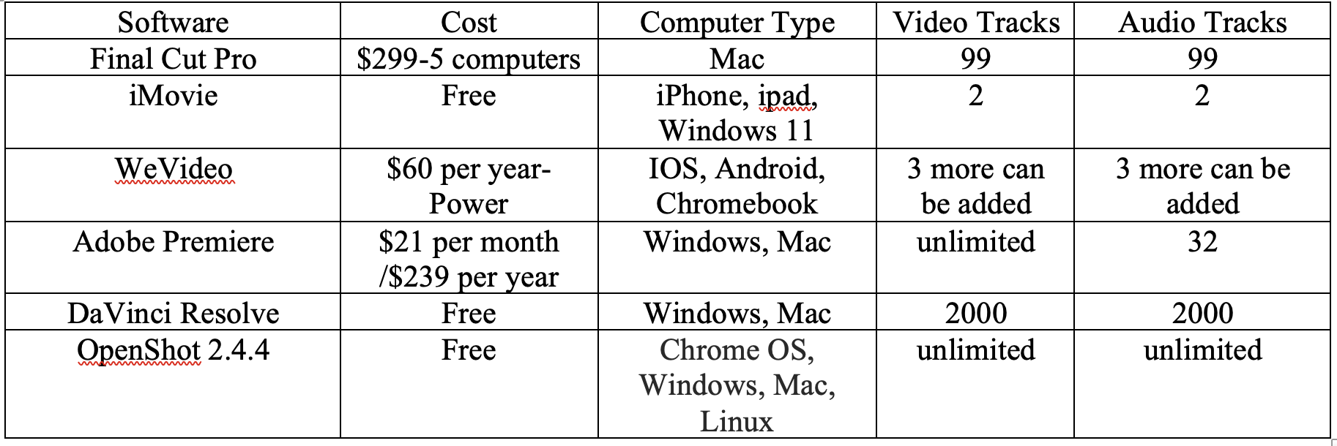
Video Software?

Slide 9
Free Video Software
Open shot video editor – all platforms
multi-tracks. Starts with 5
Transitions
Titles
Extract audio: called separate audio
Video can be stored on an external drive
Keyframes- saves values
Properties panel
Preferences- shows keyboard shortcuts
Remember to render often
Easy to use: beginner level
Not good for 4k

Slide 10
Video Software Tutorials
Open Shot Video Tutorial
Final Cut Pro-Starting out
Final Cut Pro- Editing
iMovie in 5 Minutes
WeVideo

Slide 11
Interviews
Write out and send the interviewees the questions ahead of time
Use a tripod to steady video recordings
Do not put yourself in interviews, Judges wonder who is running the camera, especially in individual documentaries
Keep interview clips short and let your analysis shine

Slide 12
Production

Slide 13
Script
Watch Sample Documentaries
Summer Royal’s Documentary
Create a Treatment
Practice several times before recording
Record in the best soundproof space possible
Narration | Visual | Audio

Slide 14
Editing
Organize your footage
Label all interviewees with their name and reason the person is a reliable source
Subtitles can help divide your documentary into sections and are great to include when the person speaking is not clear.
Take away what is not essential
Take breaks
Have others look at it- ask where are they bored?
Conclusion: end on a looking forward to the future

Slide 15
Editing
Pictures
PNG is better than JPEG: Sharper and supports a transparent background
Pixel size matters -the larger the better ….3000 best
below 1000 may become blurry
Limit the Ken Burns effect on photos-
A. Sometimes it will cause pictures to be blurry
B. Sometimes it causes too much movement

Slide 16
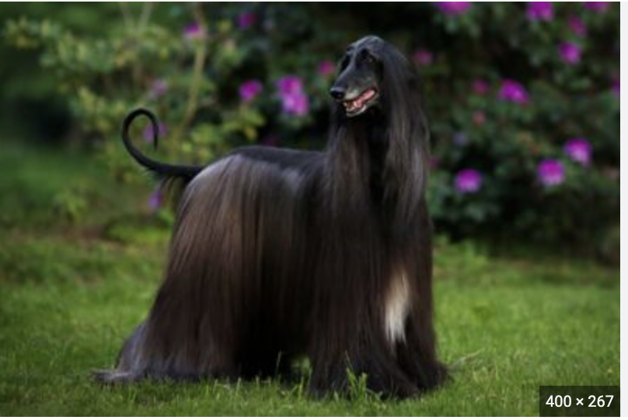
Pixel size matters -the larger the better ….3000 best
below 1000 may become blurry

Slide 17
Transitions
Keep the meaning of each transition type in mind:
Cut: Abrupt stop between shots

Slide 18
Transitions
Fade in from black: Used at the beginning to gradually become visible
Fade out to black: Used at the end to gradually become invisible

Slide 19
Transitions
Cross Dissolve: Used to show the passage of time or location –
Overlaps and replaces one shot with another

Slide 20
Transitions
Keep them consistent: There’s nothing more amateur than using different transitions for every scene.
Need suspense… then picking up the pace to create action, by using push, or cut
Keep it simple Don’t overuse Keep it smooth and natural, not forced

Slide 21
Pacing
Keep it relaxed and thoughtful
•Have others watch to see if it is too fast or too slow
•If too fast, review and remove material that is not essential
•Be careful about cutting out natural pauses

Slide 22
Credits
Readable
Brief
List: All interviews, film clips, images, and music
Cite all sources in Annotated bibliography…books, websites, interviews, clips, images, music
15-20 seconds, either stationary or very slow moving

Slide 23
Sample Credits

Slide 24
Post-Production

Slide 25
Music
Match theme
Volume-Does it overpower what is being said?
Music can be manipulative-mood, evoke a certain feeling, up with understanding
Sound
Music needs to be included in your annotated bibliography
Be careful of copyright issues

Slide 26
Sound Effects
Used to Emphasize Content
Rarely used
Keep it Simple
Mimic Reality

Slide 27
Distribution
MP4
Save to your Google Drive, One Drive, or DropBox.
Hawaiʻi excepts YouTube.

Slide 28
Questions?
Contact historyday@hihumanities.org

